Slide 1
10 June 2020

Slide 2

APPLIED CRYPTOGRAPHY
Lecture 8

Slide 3
Perfect secrecy
Can it be achieved!!!

Slide 4
Goal of secure encryption?
How would you define what it means for encryption scheme (Gen, Enc, Dec) over message space M to be secure?

Slide 5
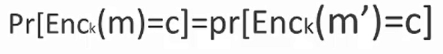
Perfect secrecy
An encryption scheme(gen, Enc, Dec) with
message space M is perfectly secret if and only
if equation (a) holds for every m,m` ∈ M
and every c ∈ C

Slide 6
Perfect (adversarial) indistinguishability
observing a ciphertext and then trying to guess which of two possible messages was encrypted
An encryption scheme is perfectly indistinguishable if no adversary A can succeed with probability better than ½.

Slide 7
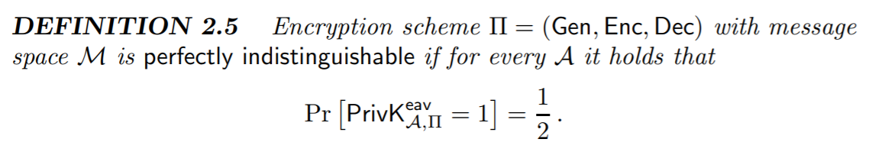

Slide 8
Probability distributions
Let K be a random variable denoting the key
K ranges over K
Fix some encryption scheme (Gen, Enc, Dec)
Gen defines a probability distribution for K: Pr[K = k] = Pr[Gen outputs key k]
Random variables M and K are independent

Slide 9
For example
If M={a,b,c,d}
K={k1,k2,k3}
P(a)=1/4 p(b)=3/10 p(c)=3/20 p(d)=3/10
P(k1)=1/4 p(k2)=1/2 p(k3)=1/4
And encryption table for M and k is given by
a b c d
K1
K2
K3 find probability distribution over c?
3 | 4 | 2 | 1
3 | 1 | 4 | 2
4 | 3 | 1 | 2

Slide 10
That is need to find Pr(c=1)
3 | 4 | 2 | 1
3 | 1 | 4 | 2
4 | 3 | 1 | 2
Pr(c=1)=
Pr(c=2)=
Pr(c=3)=
Pr(c=4)=
P(a)=1/4 p(b)=3/10 p(c)=3/20 p(d)=3/10
P(k1)=1/4 p(k2)=1/2 p(k3)=1/4

Slide 11
What will be the conditional probability distribution pr[C=c|M=m]
3 | 4 | 2 | 1
3 | 1 | 4 | 2
4 | 3 | 1 | 2
Pr(C=1|M=a)
Pr(C=2|M=a)
Pr(C=3|M=a)
Pr(C=4|M=a)
P(a)=1/4 p(b)=3/10 p(c)=3/20 p(d)=3/10
P(k1)=1/4 p(k2)=1/2 p(k3)=1/4

Slide 12
Pr[M=m|C=c]
3 | 4 | 2 | 1
3 | 1 | 4 | 2
4 | 3 | 1 | 2
P(a)=1/4 p(b)=3/10 p(c)=3/20 p(d)=3/10
P(k1)=1/4 p(k2)=1/2 p(k3)=1/4

Slide 13
Next Class
Mandatory reading for the next class
https://www.cs.miami.edu/home/burt/learning/Csc609.011/Perfect/

Slide 14


S Rajashree
Computer Science and Engineering
PES University, Bengaluru
10 June 2020

